Slide 1
Attribution Modeling

Slide 2
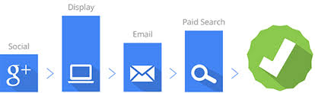
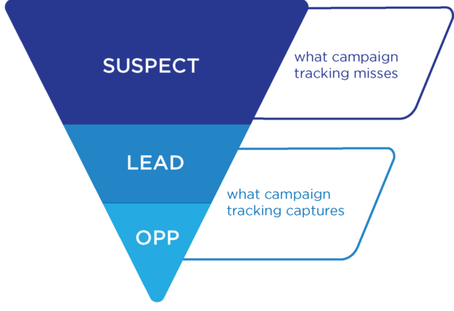
Attribution Modeling
What is Attribution?
Enable content marketers to get full credit for their work.
Why Attribution Modeling?
Understand consumer journey or path.
optimize at a very tactical level.
How to Model Attribution?
By “rules” or “statistical models”.
Operates at a micro level – device, persons, households and events.

Slide 3
Modeling Approaches
Single-touch
Multi touch attribution
Full-Path
Rule based
Regression/Survival modeling
Markov Chains
Shapley Value Method
Model based

Slide 4

Data Simulation
Generate a sample of 20k clients, randomly exposing to multiple channels and with multiple conversions.
Split journey by purchase counts: For each of the clients, the paths are split by every conversion.
Scenario one: consider a conversion is the and of a journey and the journeys within a clients are independent; journeys between clients are independent.
Scenario two: model separately for different stage (the journey to the first conversion, second conversion …), compare the marketing channels effects for the differences.
The different approaches to calculate the attributions are illustrated under scenario one; more simulations for scenario two are presented at the end.

Slide 5
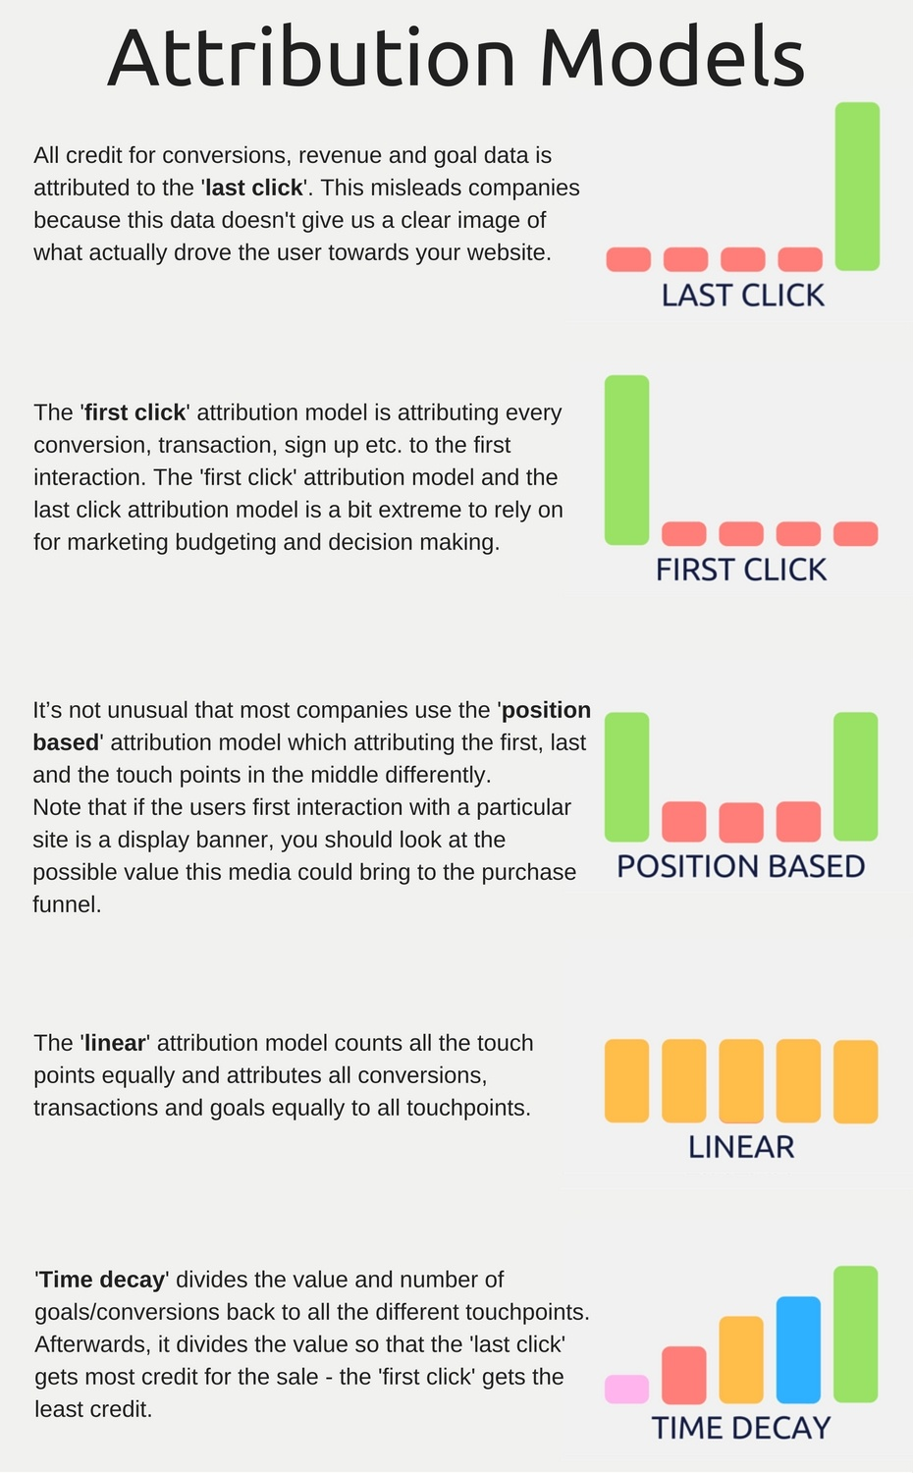
Rule Based Models

Slide 6
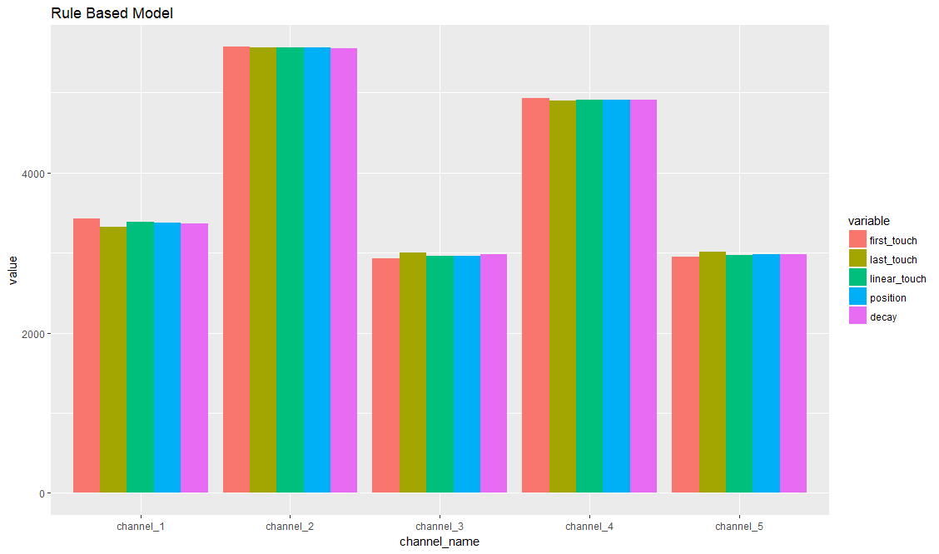
Rule Based-Simulation Results
Simulate the customer journey, with occurrence of each channel ( 0.17, 0.28, 0.15, 0.25, 0.15).
Create the journey path.
The attribution of each channel based on first touch, last touch, linear touch, first and last position, and time decay are obtained.

Slide 7
Markov Chain Model
Path:
The customer journey (sequence of channels/touchpoints) is considered as a chain in a directed Markov graph.
Each vertex is a possible state (transient – channel/start, sink - conv/null) and the edges represent the probability of transition between the states
Modeling:
The attribution of every channel/touchpoint could obtained by modeling a Markov Chain and estimating transition probabilities across channels.

Slide 8
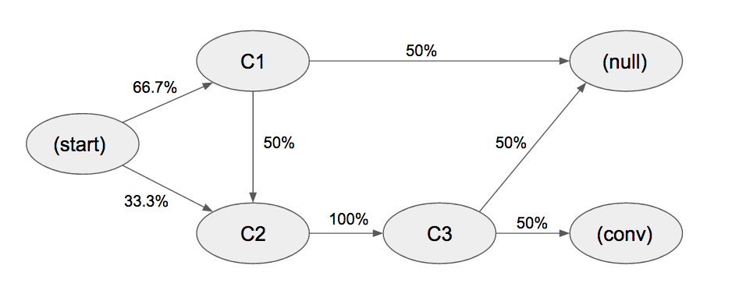
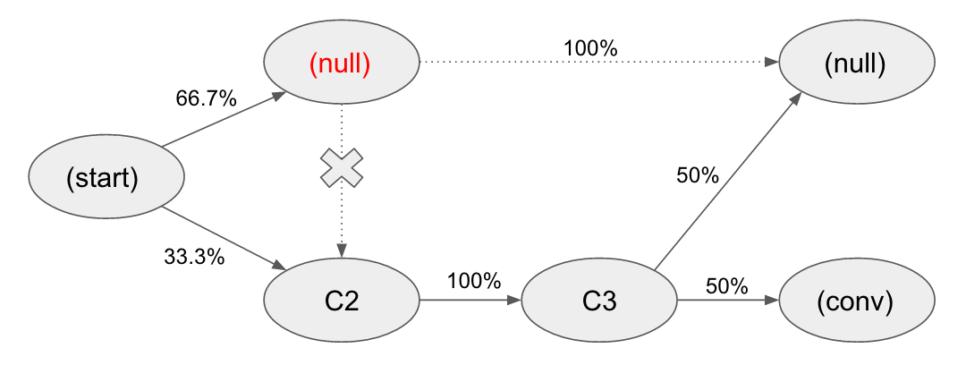
Markov Chain- Algorithm
C1 -> C2 -> C3 -> purchase
C1 -> unsuccessful conversion
C2 -> C3 -> unsuccessful conversion
Step 1: collect the customer journeys, for example, three customer journeys
Step 2: denote the Markov chain path as graph:
Step 3: the contribution of each channel are calculate by removing and measure how many conversions reduced, e.g. removing C1
probability of conversion of the complete model is 33.3% (0.667 * 0.5 * 1 * 0.5 + 0.333 * 1 * 0.5.)
The probability of conversion after removing the C1 channel is 16.7% (0.333 * 1 * 0.5.)
Therefore, the channel C1 removal effect is 0.5 (1 – 0.167 / 0.333.). Repeat this process for all channels (C2 = 1 and C3 =1)
Step 4: the allocation
C1: 0.5 / (0.5 + 1 + 1) = 0.2
C2: 1 / (0.5 + 1 + 1) = 0.4
C3: 1 / (0.5 + 1 + 1) = 0.4

Slide 9
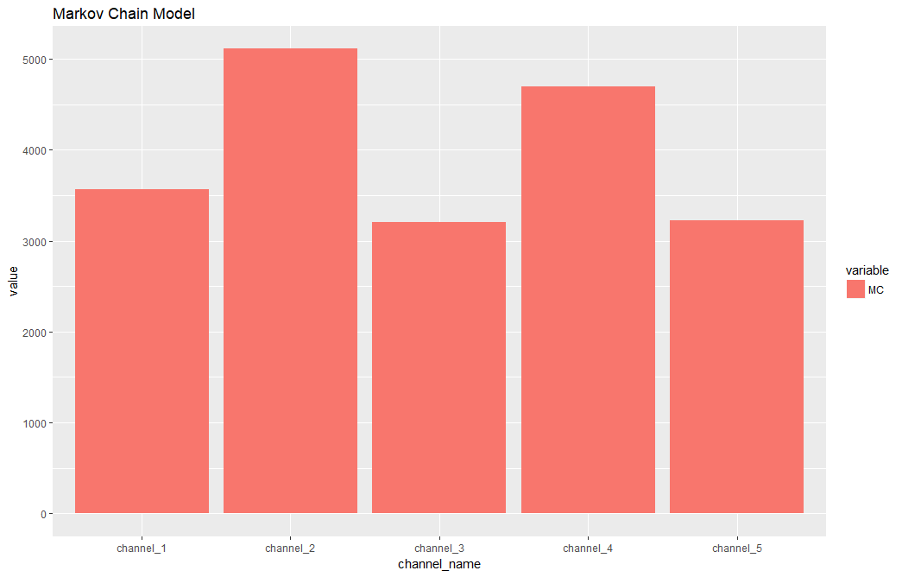
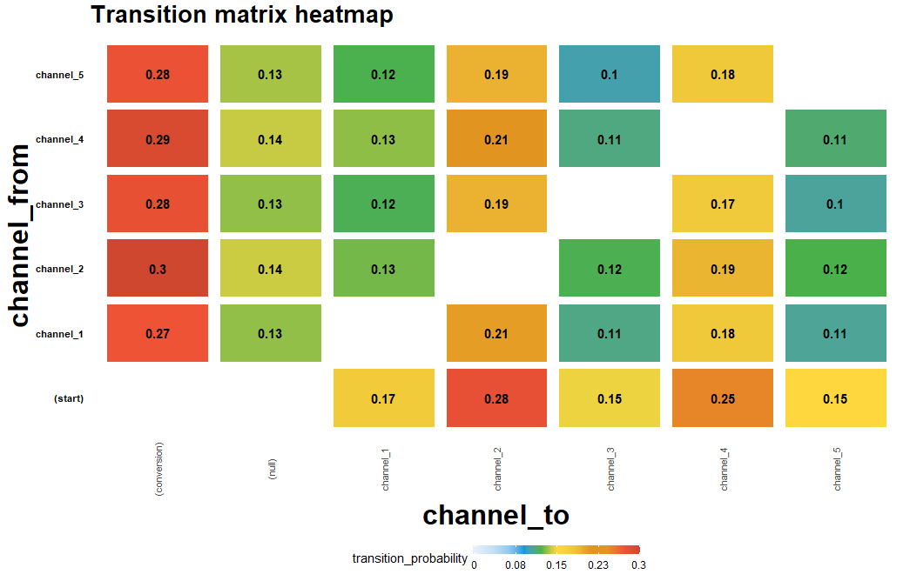
Markov Chain -Results
Summary of the transition of the Markov Chain
The contribution of channels

Slide 10
Shapley Value Method
In game theory, Shapley value applies primarily in situations when the contributions of each player when they play together. It ensure each player gains as much or more as they would have from playing independently.
Shapely Value captures the “average marginal contribution” of channel i, averaging over all the different sequences according to which the combination could be built up from the empty model.

Slide 11

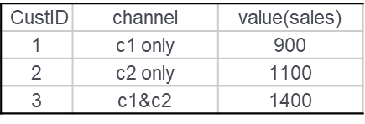
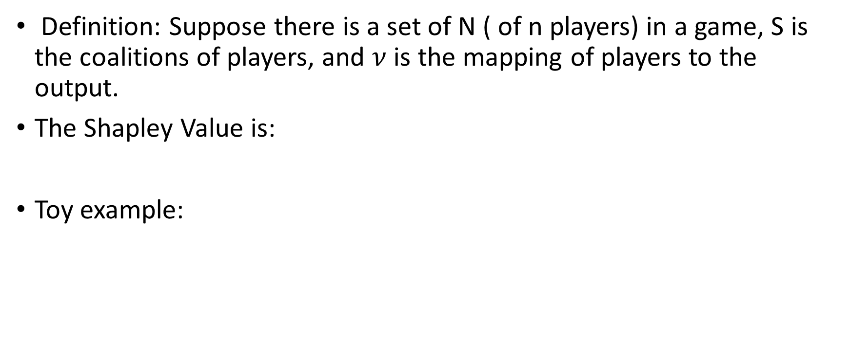
Shapley Value-Algorithm
Definition: Suppose there is a set of N ( of n players) in a game, S is the coalitions of players, and $ν$ is the mapping of players to the output.
The Shapley Value is:
Toy example:
Input Data (the conversation/sales by each channel combinations)
calculate the average of the marginal share
The Credit Distribution

Slide 12
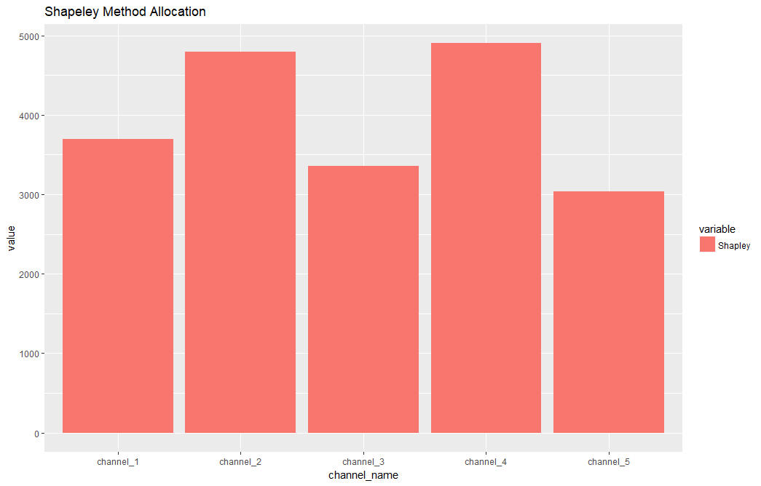
Shapley Value-Simulation Results
Create the conversion combinations
Calculate the marginal combination of the each channel
Calculate the cumulative attribution
Disadvantages: It is possible that the marginal contributions of some channels are negative. But the cumulative contribution still be positive

Slide 13
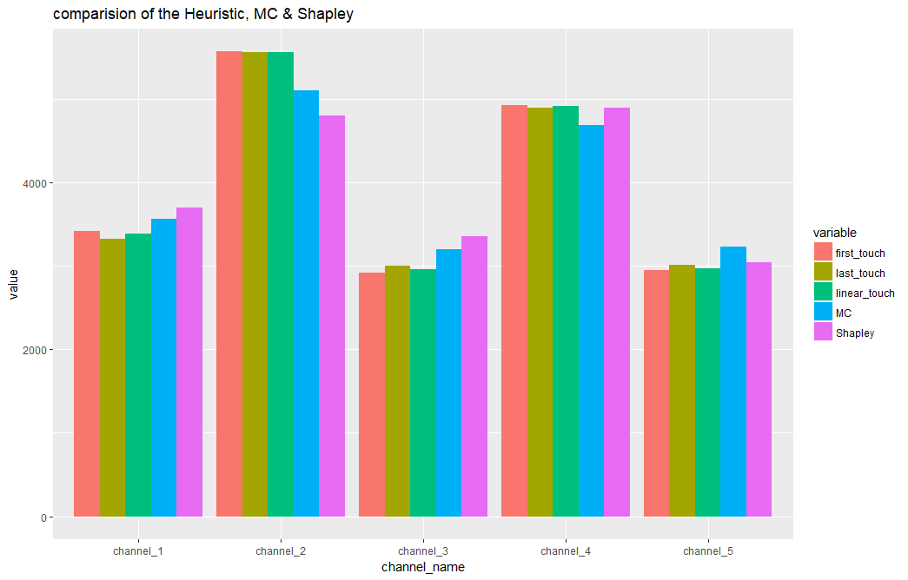
Comparison of different Approaches

Slide 14
Regression Model/Logistic Regression Model
Regression model or logistic regression models are fitted to model the sales/conversion for each of the customer exposure.
The contribution of each variable is evaluated by the relative importance/marginal contribution of individual predictors.
Relative importance: evaluated by the absolute value of the t-statistics (to test a feature is effective or not in the model) for each of the model parameters.
Marginal contribution: controlling all other variables in the model, and check the model deviances.
For logistic regression, bagging approaches are also considered.

Slide 15
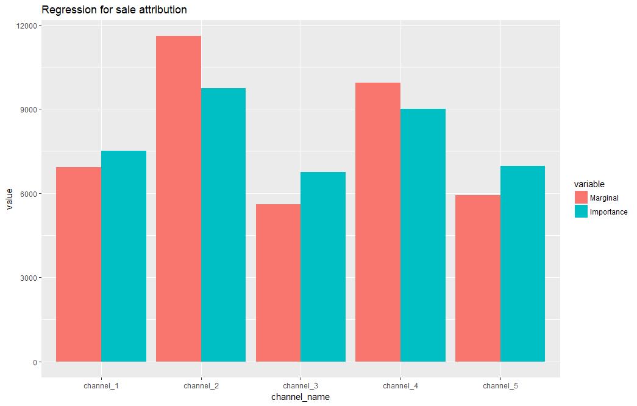
Regression- Simulation
Build regression model sales ~ channel1 + channel 2 + channel3 + channel4 + channel5 (count the exposure time of each channel)
Find out the variable contributions: relative importance/marginal contribution
Allocate the contribution of each channel

Slide 16
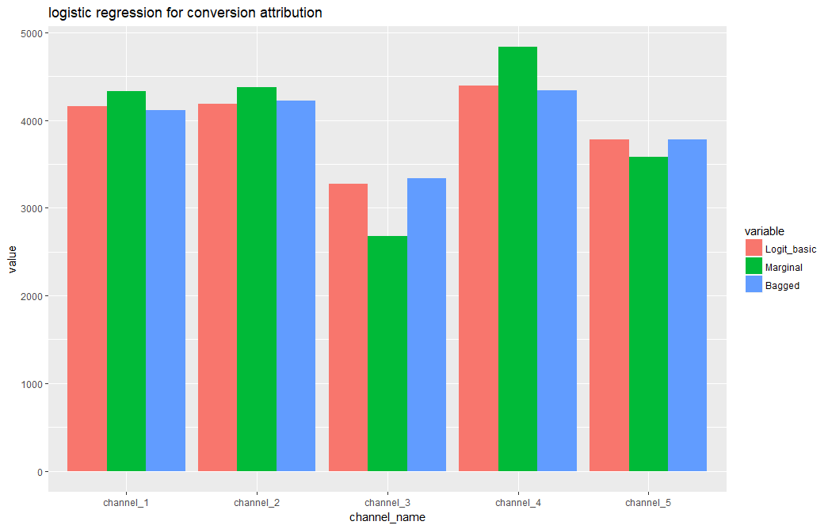
Logistic Regression- Simulation Results
Build logistic regression model conversion ~ f(channel1 + channel 2 + channel3 + channel4 + channel5)
Find out the variable contributions: relative importance/marginal contribution
The relative importance of the bagged logistic regression are used as contribution

Slide 17
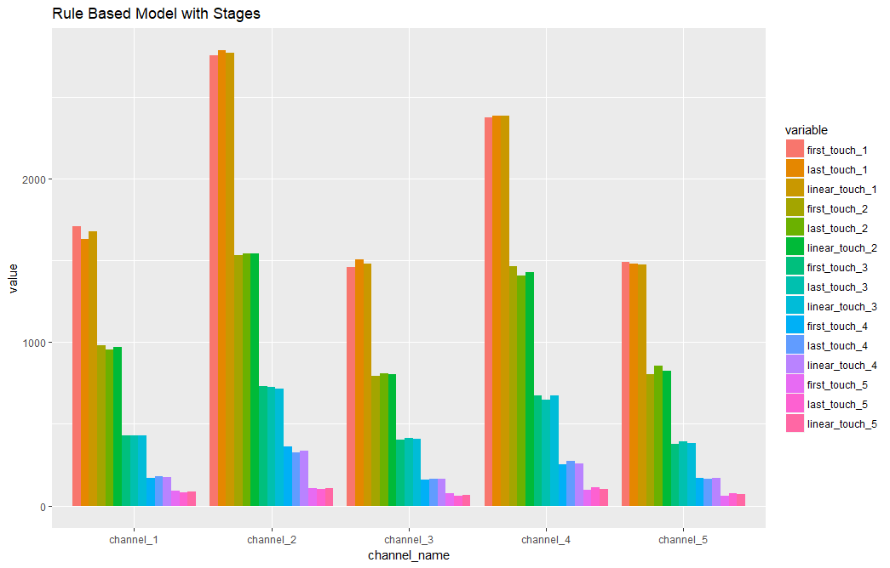
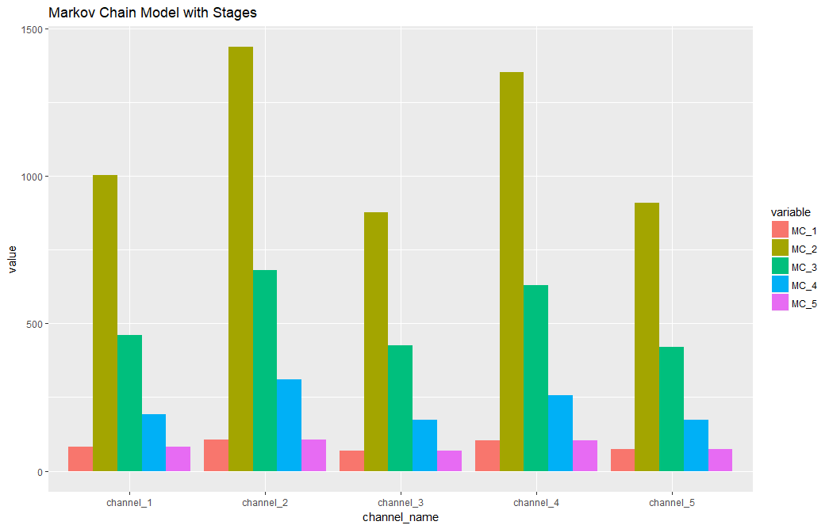
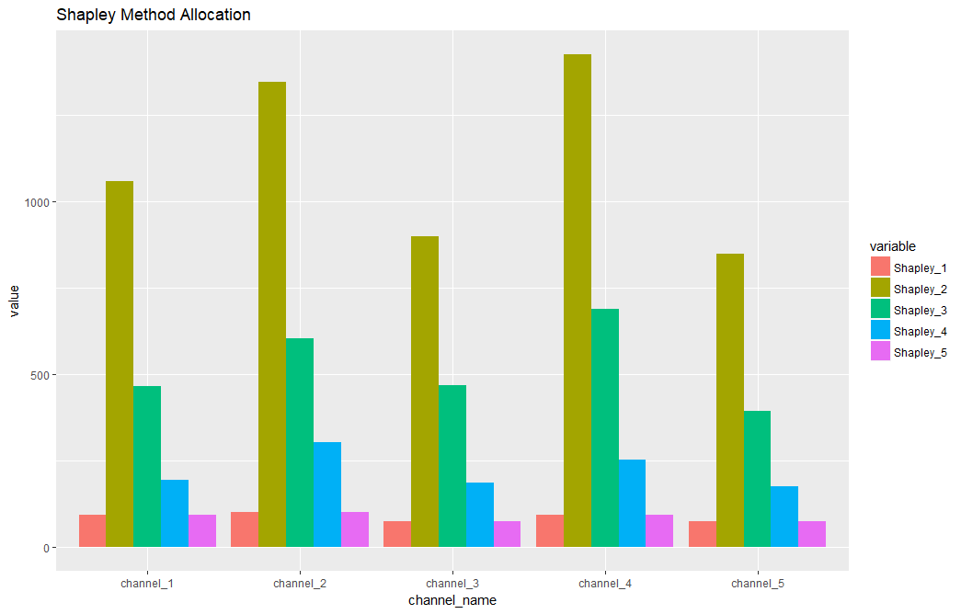
Scenario Two: Compare the Attribution by Channels and by Stages
Heuristic, Markov Chain & Shapley

Slide 18
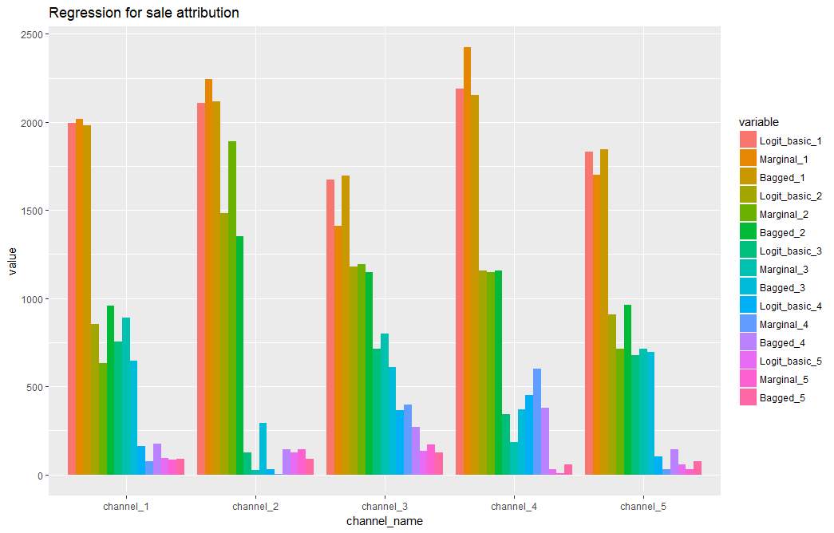
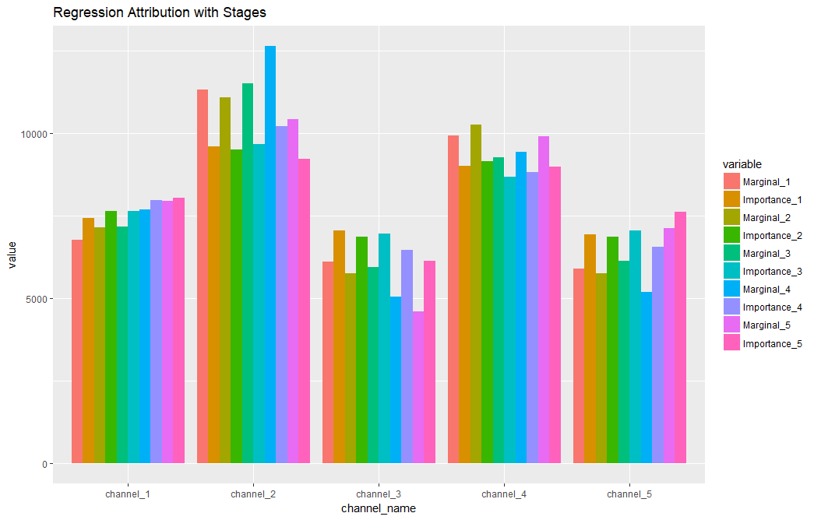
Scenario Two: Compare the Attribution by Channels and by Stages
Regression & Logistic Regression

Slide 19
Comparison
 | Rule Based | Regression | Markov Chain | Shapely Value
All channels | Yes | Yes | Yes | Yes
Exposure path | Yes/No | No | Yes | No
Exposure time | No | Yes | No | No
Repeated exposure | Yes/No | Yes | Yes | No
Exposure intense / Type(direct, mass) | No | Yes | No | No

Slide 20
References
https://analytics.google.com
https://www.sas.com/Attribution/White-Paper
Sergey Bryl’ “Marketing Multi-Channel Attribution Model with R (Part 1 & Part 2)”[Online]; Available: https://analyzecore.com/2016/08/03/attribution-model-r-part-1/ https://analyzecore.com/2017/05/31/marketing-multi-channel-attribution-model-r-part-2-practical-issues/
Shao, X. and Li L. “Data-Driven Multi-Touch Attribution Models ” Proceedins of the 17th ACM SIGKDD International Conference on Knowledge Discovery and Data mining, 2011.
AE Roth, RE Verrechina. “The Sharpley value as applied to cost allocation: a reinterpretation”. Journal of Accounting Research 1979.

